Slide 1


EV3 Classroom: PID Line Follower

Slide 2
Lesson Objectives
Learn the limitations of proportional control
Learn what PID means
Learn how to program PID and how to tune
Prerequisites: Math Blocks, Color Sensor Calibration, Data Wires, Variables, Proportional Control
We highly recommend knowledge of Algebra at a minimum. PID is a calculus-based concept and students should understand why it is used and the math behind it before using it.
Please use Presentation Mode as there are lots of animations.

Slide 3
When does Proportional Control Have Trouble?
What would a human do?
What would proportional control do?
On line → go straight
On white → turn left
Moving across line → turn right
On white → turn left
Getting further from line → turn even more!
On line → go straight
On white → turn left
Moving across line → go straight!
On white → turn left
Getting further from line → turn left the same amount!
50%
LIGHT READING =
100%

Slide 4
How can we fix Proportional Control?
What would a human do?
What would proportional control do?
Turning left/on line → turn right
Getting further from line → turn even more!
Turning left/on line → go straight!
Getting further from line → turn left the same amount!
1. Predict what the next sensor reading will be
2. Has past steering fixes helped reduce error?

Slide 5
Integrals and Derivatives
1. Predict what the next sensor reading will be?
2. Have past steering fixes helped reduce error?
If readings are: 75, 65, 55 → what do you think the next reading will be?
What if the readings were 57, 56, 55…
What information did you use to guess?
Derivative ➔ the rate at which a value is changing
When the correction is working well, what does error readings look like?
+5, -6, +4 -3…. i.e. bouncing around 0
When steering is not working, what does error look like?
+5, +5, +6, +5… i.e. always on one side of 0
How can we detect this easily?
Hint: look at the sum of all past errors
What is an ideal value for this sum? What does it mean if the sum is large?
Integral ➔ the “sum” of values

Slide 6
What is PID?
Proportional [Error] → How bad is the situation now?
Integral → Have my past fixes helped fix things?
Derivative → How is the situation changing?
PID control → combine the error, integral and derivative values to decide how to steer the robot

Slide 7
Error
Solid line represents what you have seen, dotted line is the future
At time 20, you see light reading = 40 and error = -10 (red X)
Subtract target (50)

Slide 8
Integral
Looks at past history of line follower
Sum of past error
Like area under the curve in graph (integral)
Green = positive area
Red = negative area

Slide 9
Derivative
How quickly is position changing?
Predicts where the robot will be in the immediate future
Same as how fast is error changing
Can be measured using tangent line to measurements → derivative
Approximated using two nearby points on graph
Tangent line

Slide 10
Pseudocode
Take a new light sensor reading
Compute the “error”
Scale error to determine contribution to steering update (proportional control)
Use error to update integral (sum of all past errors)
Scale integral to determine contribution to steering update (integral control)
Use error to update derivative (difference from last error)
Scale derivative to determine contribution to steering update (derivative control)
Combine P, I, and D feedback and steer robot

Slide 11
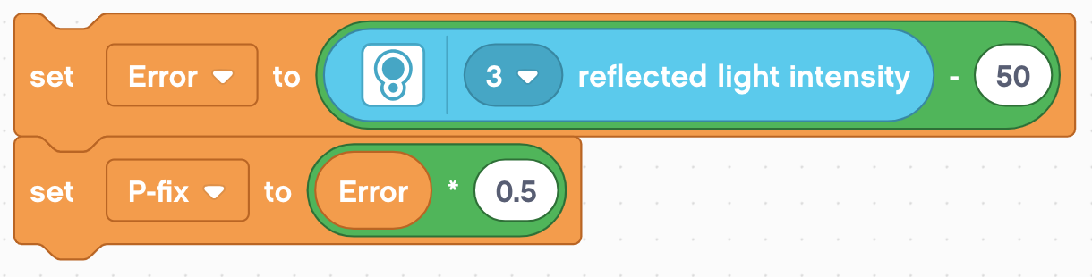
Code - Proportional
This is the same as the proportional control code
Error = distance from line = reading - target
Correction (P_fix) = Error scaled by proportional constant (K_{p}) = 0.5

Slide 12
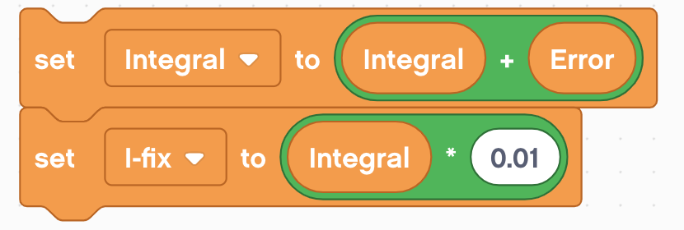
Code - Integral
This section calculates the integral. It adds the current error to a variable that has the sum of all the previous errors.
The scaling constant is usually small since Integral can be large
Integral = sum of all past errors = last integral + newest error
Correction (I_fix) = Integral scaled by proportional constant (K_{i}) = 0.01

Slide 13
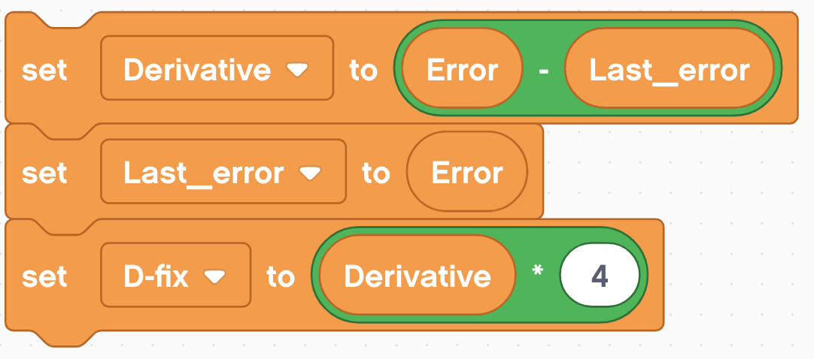
Code - Derivative
This section of code calculates the derivative. It subtracts the current error from the past error to find the change in error.
Derivative = rate of change of error = current error – last error
Correction (D_fix) = Derivative scaled by proportional constant (K_{d}) = 4.0

Slide 14
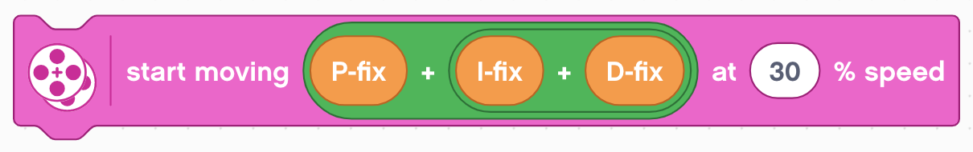
Putting it all Together
Each of the components have already been scaled. At this point we can simply add them together.
Apply the correction the the steering of a move steering block
Add the three fixes for P, I, and D together. This will compute the final correction

Slide 15
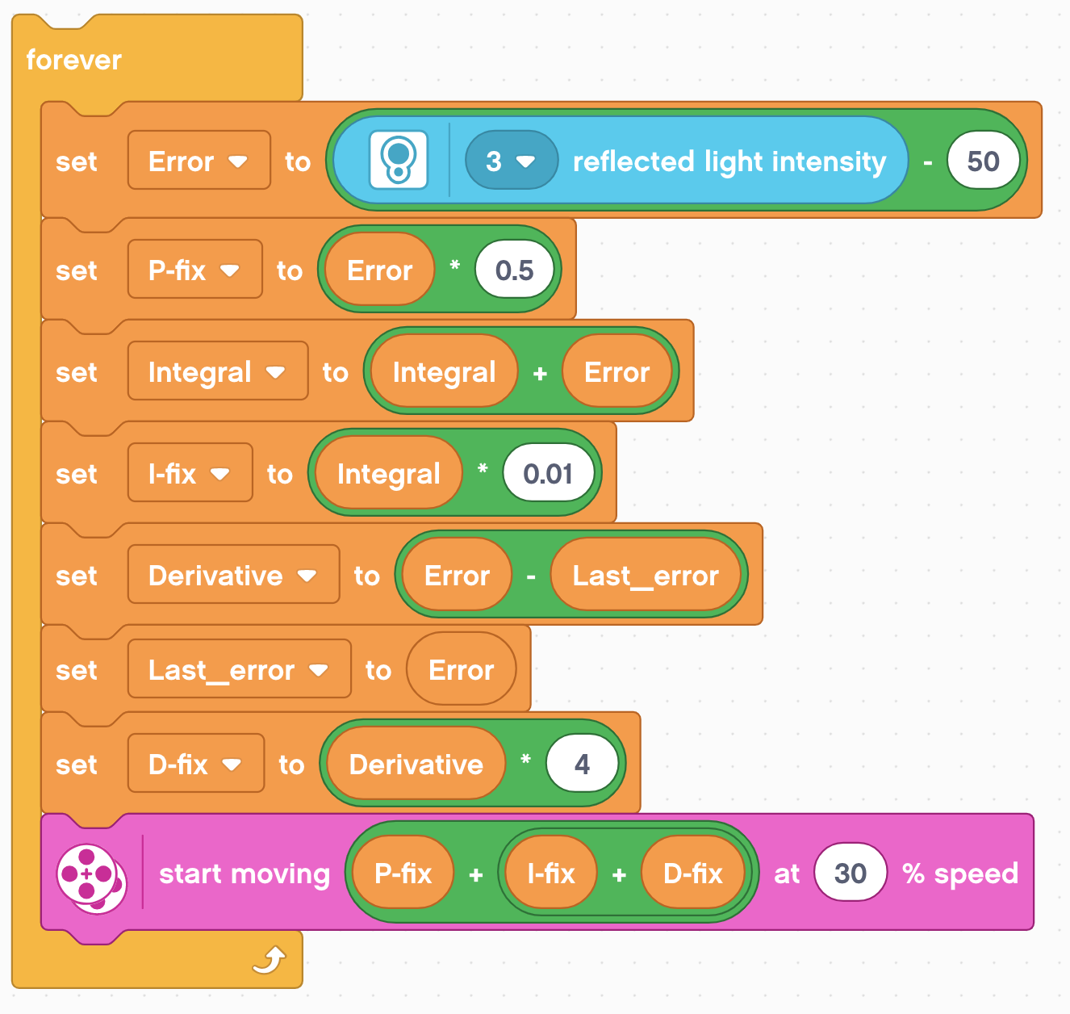
Full Code
This is what you get if you put all these parts together.
We hope you now understand how PID works a bit better.
Proportional
Integral
Derivative
Putting it all Together

Slide 16
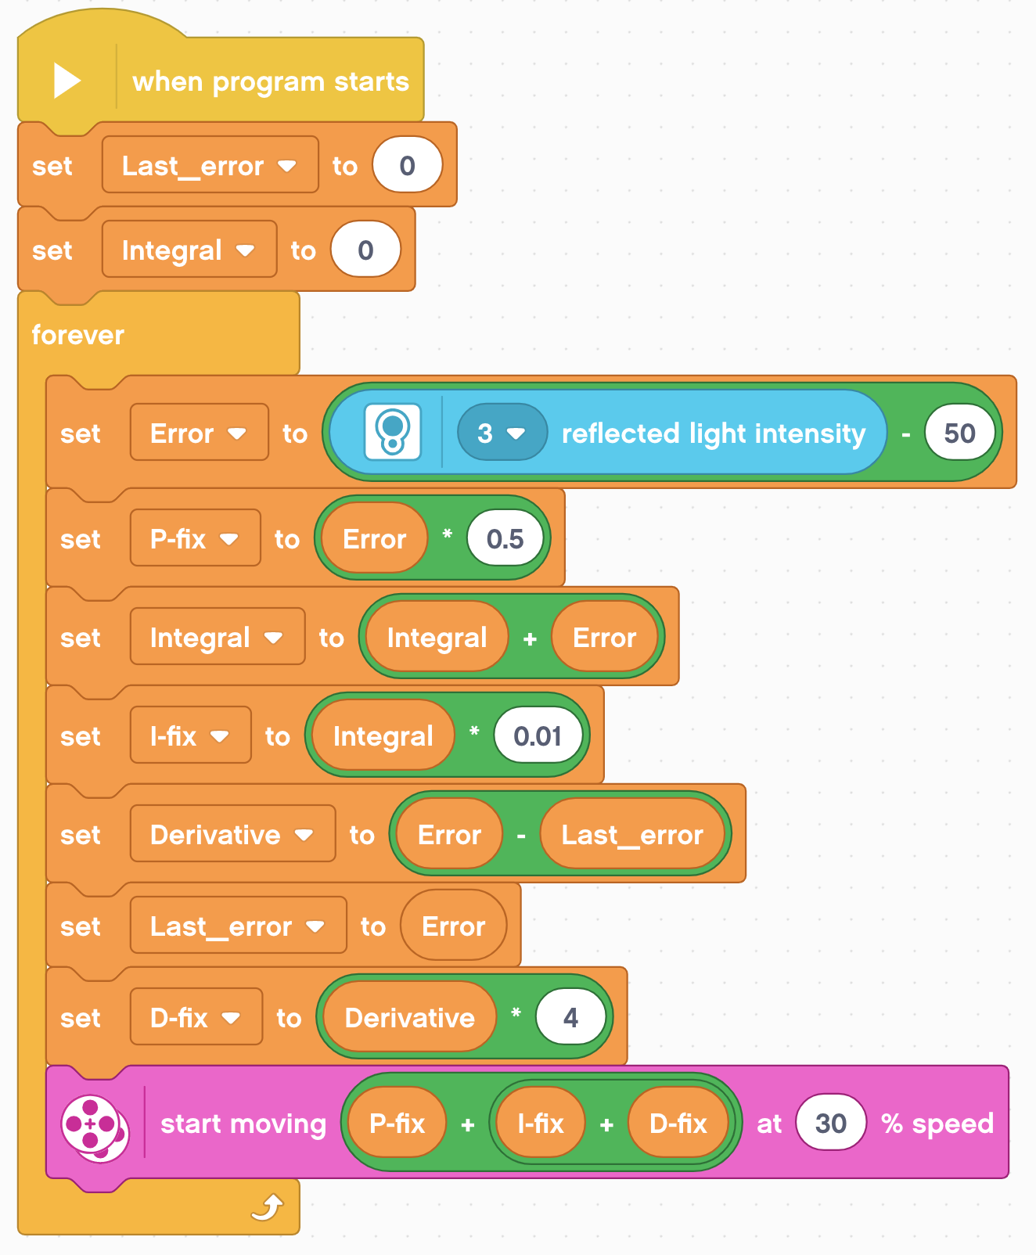
Full Code
Set up the variables for the last error and integral before the loop and initialize to 0 because they are read before being written.
Proportional
Integral
Derivative
Putting it all Together

Slide 17
Key Step: Tuning The PID constants
The most common way to tune your PID constants is trial and error.
This can take time. Here are some tips:
Disable everything but the proportional part (set the other constants to zero). Adjust just the proportional constant until robot follows the line well.
Then, enable the integral and adjust until it provides good performance on a range of lines.
Finally, enable the derivative and adjust until you are satisfied with the line following.
When enabling each segment, here are some good numbers to start with for the constants:
P: 1.0 adjust by ±0.5 initially and ±0.1 for fine tuning
I: 0.05 adjust by ±0.01 initial and ±0.005 for fine tuning
D: 1.0 adjust by ±0.5 initially and ±0.1 for fine tuning

Slide 18
Evaluating Line followers
Proportional
PID
Uses the “P” in PID
Makes proportional turns
Works well on both straight and curved lines
Good for intermediate to advanced teams → need to know math blocks and data wires
It is better than proportional control on a very curved line, as the robot adapts to the curviness
However, for FIRST LEGO League, which mostly has straight lines, proportional control can be sufficient

Slide 19
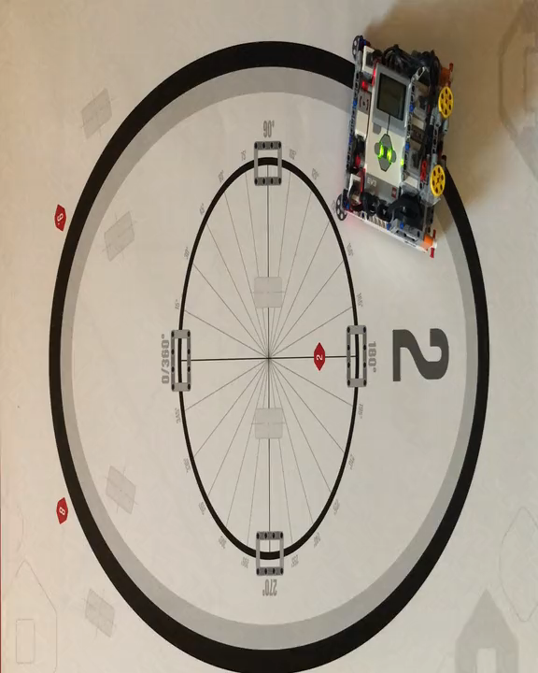
Proportional Control (0.6 Constant)

Slide 20
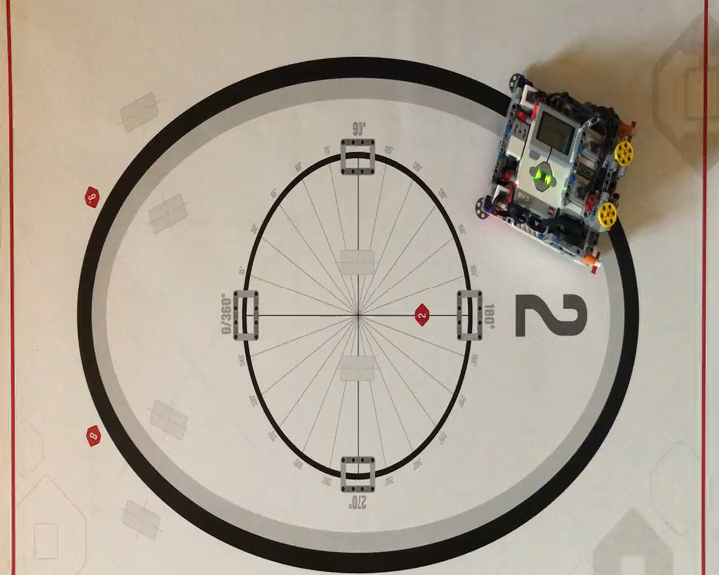
Proportional Control (0.8 Constant)

Slide 21
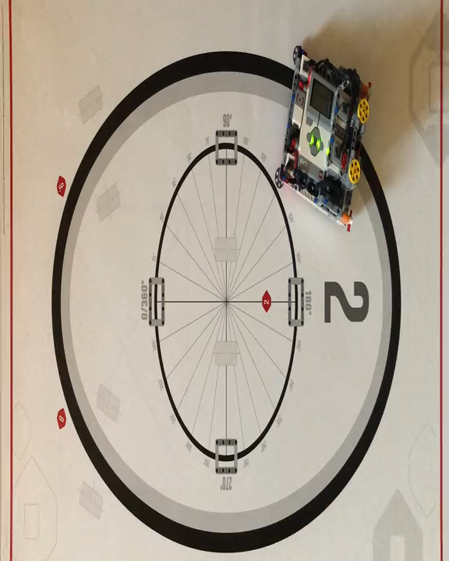
PID Control

Slide 22

CREDITS
This tutorial was created by Sanjay Seshan and Arvind Seshan
More lessons at www.ev3lessons.com
This work is licensed under a Creative Commons Attribution-NonCommercial-ShareAlike 4.0 International License.

